Slide 1

#AgileCamp2019
@GoAgileCamp
AgileCamp
Migrating from Project to Product : Tips and tricks to make the transition
Leo Mattos, Agile Delivery Operations CoE, SAP
@mattos_leonardo
Leonardo.mattos@gmail.com

Slide 2


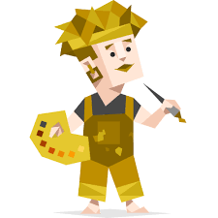



MESSAGE FROM
LEO MATTOS
Agile Delivery CoE
Developer
Soccer coach
Adventurer
IT Services
Director
20+ years
In the industry
Licensed for kids
U10 - U16
Meyers Briggs
abbreviated test
Notes:
https://pixabay.com/en/write-plan-business-startup-593333/

Slide 3
Goals for today
Context
1st attempt
Define Product
Success is possible
What we will talk about
State how was before the migration was and why we started it
Define effectively product and discuss the characteristics of a good product. What the transformation should looks like
Report from my 2nd attempt migration and tips and tricks we can take from it
Transformation I went through and why it failed

Slide 4

Have you seen this before?
Notes:
Here a story telling about our time in JPMChase where we were trying to be agile, individually. Not scalling to other teams and being limited on value delivery and business agility. We were still delivering every month and all but with a lot of changing the requirements, with lots of dependencies and
Negative aspects:
1) Yearly budget : setup one year of planning 1 year ahead - futurology
2) Multiple bosses : small projects from many different sources and having to allocate
3) Monthly release : doing our best or the possible on a controlled environment to release frequently
4) We had 3 teams supporting the application
We changed what we could
5) Show the some of the metrics.
Can you see what were the mistakes we made or the roadblocks we faced to scale agile?

Slide 5
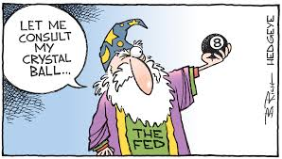
Have you seen this before?

Slide 6

Have you seen this before?

Slide 7
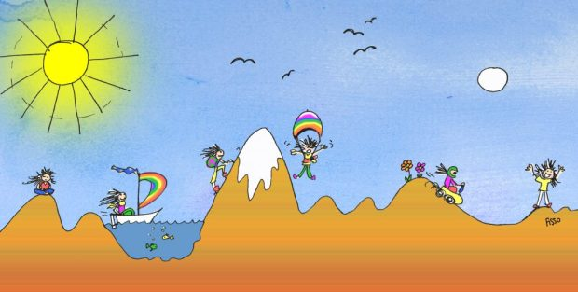
And this is how I did our transformation
Scoped Application we support
Break down project into features and build road map
Value stream mapping
Technical improvements based on bottom necks
Governance and small organization change to respond to siloed org

Slide 8

Result
Local optimization all around
We did not align the WHAT and WHY from business, with the HOW from engineering
No real business product view
No system wide improvements
Still yearly plan and delivering everything at the end of the year
Notes:
That is a boom!!! Showing picture suggesting going really south.
Highlight here the failed aspects.

Slide 9

Defining a product
” A product is something (physical or not) created through a process that provides benefits to a market ”
“A Cohesive set of applications, components, and services that provide user value”
Packaged
Has a producer
Has a target customer
Product Vision
Product Canvas
Roadmap
Notes:
A Cohesive set of applications, components, and services that provide user value.
1- Things stick together. They belong together. They often change together.
2- Consist of 1 or mote of these things
3- Solves some problem. Ideally for a human.

Slide 10
Considerations to design products
Connect with a purpose
Avoid the components base products.
E2E business value stream
Dependencies
Allocation of resources
Notes:
Here to place some tipis about defining the product…. Like value stream mapping on business size, mapping the goals and dependencies…….. Including business or clients on this as well.
Can I give it a customer centric name?
Could I bundle and sell it to someone?
Can it stand on its own? Can I make changes to it without strong dependies on other products?
What are the main customer goals it satisfies? Can I describe them in less than 2 sentences?

Slide 11
Then how doing right looks like
Define the product development process and roles
Thinking on outcome instead of output
Define products and supporting teams
Value Stream Mapping
Design your software solution accordingly
Build product pipeline with transparent prioritization process and metrics
Change the funding process and feature teams
Notes:
List here the aspects that need to be considered…. Maybe considering some flow framework or something.
This is a significant shift from the mindset of project thinking. Rather than focusing on timelines and dates, we focus on the goal we want to achieve or the job to be done. Because we’re focused on the outcome rather than the output, it is much more difficult to put time constraints around the delivery, at least up front. Primarily because we don’t necessarily know how we’re going to accomplish the goal up front.
Product mode is a way of working. It is a way of funding and organizing software development that differs significantly from projects way of doing it. Althought generaly applicable to digital-age enterprise IT, this way of working is specially suited to those who aim to drive business though a digital platform.
Traditional Project Management when applied to a complex software product is the art of wrong things right ( on time, in budget, and to scope). Agile Product Leadership is about accepting the plan is likely wrong or ar very least unclear and the scope is unknonw, and so adapting to change and building the right things to fulfil customers needs.

Slide 12
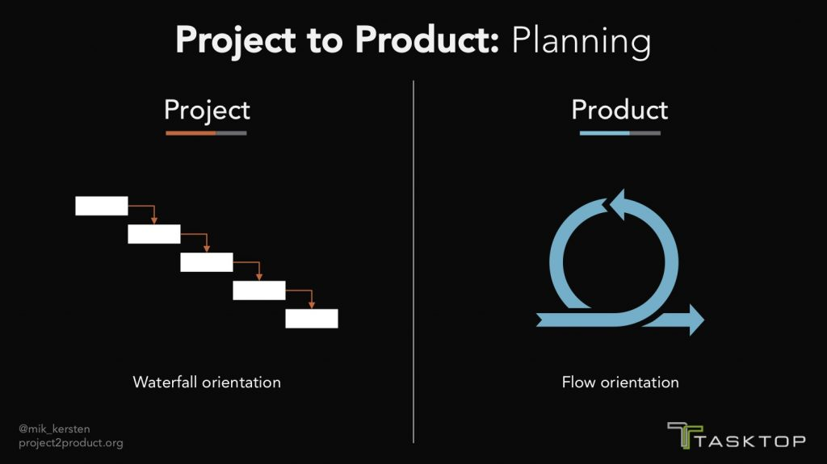
Then how doing right looks like
Notes:
You can go from this waterfall world of projects, where again, you’re assuming that you know exactly what you should be delivering for years on end, to this flow orientation but measure the results of that flow orientation.

Slide 13
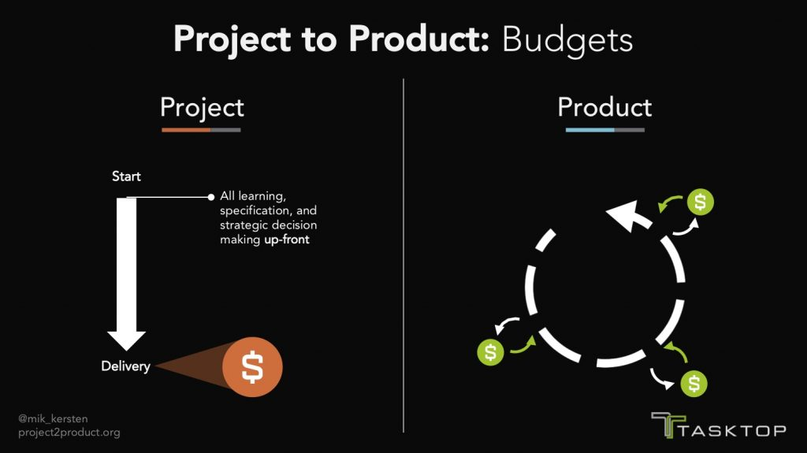
Then how doing right looks like
Notes:
You can go from this world where everything has to be specified up front, to creating a project development budget, that allows for the reallocation of budgets between project value streams on a much shorter time frame than a year. Then you can adapt to your market for wherever you are getting those business results.

Slide 14
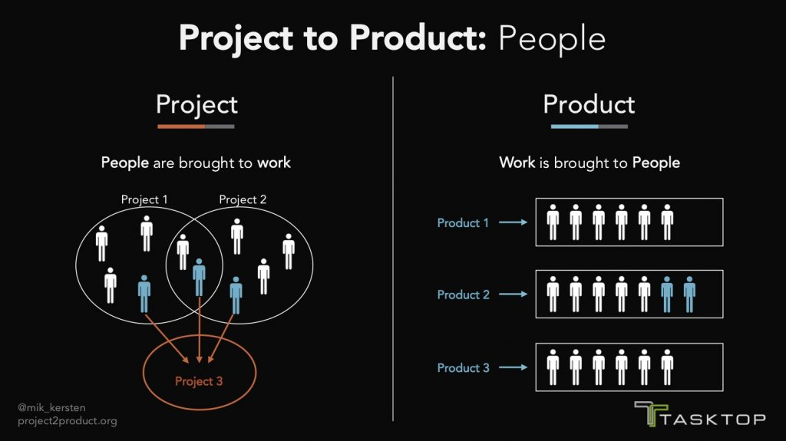
Then how doing right looks like
Notes:
And of course, this key thing is that you stop bringing people to the work — you bring work to the people. You allow those teams to form stable value streams that are bigger than just feature teams.
Feature teams are a great start, but you give the entire value stream, the ability to have autonomy, mastery, and purpose, and you allow them to set the flow distribution.
Those teams, the product value streams will know, when they should reduce more tech debt for example, to reach a north star, where as where they should run faster on feature delivery.

Slide 15
Tips and tricks
1
Fund teams and not projects
6
Attached value base metrics to validate business hypothesis
2
Fund entire product lifecycle
7
Define success and make it visible to everyone
3
Ideate, build and run as a single department
8
Take “Conway’s law” seriously and make it work on your side
4
Develop log lasting teams around purpose and ownership
9
Design the tool network from the different tools used on product lifecycle
5
Visualize work with transparent product roadmap
10
Allocating work ( features ) to teams instead of people to work.
Notes:
Here list the tools to have on the toolbox to since defining the product and to change management.
Funding : For building, running and iterating on the solution or even pivoting to a different solution till the underlying problem is verifiably solved
Ideate, build and run as a single deparment with unified reporting hierarchy
5. Roadmap items are priorititized by product owners and their business counterparties. Cross cutting initiatives are prioritized by the business or tech leadership. Inititiatives don’t ghet their own team. They are parceled out to pre existing product mode teams.
6. Product owners prove actual benefits either with data from A/B testing, analytic, user surveys, etc…. Or with feedback from business. Engineer for early feedback with good practices to release frequently in small chunks and good analytic capabilities to determine delta changes in adoption, conversion, etc…
7. Improved of a metric directly related to a business outcome or not more than one or two levels removed from a business outcome. Thus, every product mode team is ideally a business KPI driven team
8. Product mode works best when teams are organized to be simultaneaously aligned with business relevant capabilities and with enterprise architecture boundaries. Without business capabilities they loose alignment with business goals. Without enterprise architecture alignment, they loose out on autonomy, for instance the ability to evolve their system relatively independent of the others teams.
10. Allocating work ( features ) to teams instead of people to work. Increaes commitment ownership, velocity and morale.

Slide 16
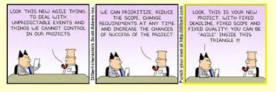
Thank you!!
“ So whenever you’re thinking of asking for an estimate, you should always clarify what decision that estimate is informing. If you can’t find one, or the decision isn’t very significant, then that’s a signal that an estimate is wasteful. “
Martin Fowler

